Slide 1
A Method for Registration of 3-D Shapes
P. J. Besl and N. D. McKay, "A method for registration of 3-D shapes,“ in IEEE Transactions on Pattern Analysis and Machine Intelligence, vol. 14, no. 2, pp. 239-256, Feb. 1992
Brief Summary
: Proposal for Registration of two point-cloud sets.
1) Distance calculation - Point to Point, Point to line, Point to Plane, Point to Entity.
2) Optimization - Object function - LMS, Gradient Descent, Steepest Descent, etc.
3) Point Set registration - Using Quaternion, Center of mass, cross-covariance.
4) ICP, Iterative Closest Point Algorithm
- Statement and Convergence theorem
5) Experiment
- Point to Point, Line, Surface
Conclusion
: Handling 6-DoF / Initial pose(state) problem, Fail case

Slide 2
1. Introduction
What is Registration
서로 다른 좌표계의 형상을 기준 좌표계로 변환하여 정렬하는 것을 말함.
Why it needed?
LiDAR SLAM
Medical Image (CT 와 MRI데이터의 정합)
3D Scan data
AR/VR
Computer Vision
Goal (of this paper)
Generalize to n dimensions
Provide solutions to 1) Point-set matching problem without Correspondence 2) free-form curve matching problem
Pre-condition
고정밀 장비를 사용하므로, 측정 점들의 불확실성은 배제한다. (unequal uncertainty among points)
이상치 (Outlier) 의 제거는 전처리 과정이므로 다루지 않는다.
Applicable data type

Slide 3
2. Literature review
[18] O. D. Faugeras and M. Hebert, “The representation, recognition, and locatin g of 3-D objects,” Int. J. Robotic Res. vol. 5, no. 3. pp 27-52, Fall 1986 : Using Quatornian for Least Square Registration of 3D shape → 형상 내에 일정 크기 이상의 평면이 존재한다는 가정으로 인해 제약사항이 발생
[50] Schwartz JT, Sharir M. Identification of Partially Obscured Objects in Two and Three Dimensions by Matching Noisy Characteristic Curves. The International Journal of Robotics Research. 1987 : Free-form space curve matching problem w/o feature extraction using non-quaternion approach to computing LSM → difficulty with noisy data.
[28] R. M. Haralick et al., “Pose estimation form corresponding point data,” in Machine Vision for Inspection and Measurement (H. Freeman, Ed). New York: Academic, 1989. : LSM with SVD, able to handle outlier
[55] G. Taubin, “Algebric nonplanar curve and surface estimation in 3-space with applications to position estimation,” Tech. Rep. LEMS-43 Div. Eng., Brown Univ., Providence, RI, 1988 : Algebric estimation → But Lack of practical proof for complex surface
[54] R. Szeliski, “Estimating motion from sparse range data without correspondence”, 2nd int. conf. Comput. Vision (Tarpon Springs, FL),Dec. 5-8,1988, pp207-216. : 부족한 데이터를 바탕으로 / 점들간의 대응없이, 특징점의 추출없이 Motion을 추정함. Conventional Steepest descent Mehtod와 Noise reductio을 위한 Bayesian filte의 사용. → Local minima로 접근하는 속도가 느리고 (computing cost), 실험 케이스가 단순하고 제한적임
[33] B. K. P. Horn, and J. G. Harris, “Rigid body motion form range image sequence,” Comput. Vision Graphics Image Processing, 1989. : Non-iterative LSM in 6 DoF motion, much quicker than Szeliski → Not clear to genealize
[36] B. Kamgar-Parsi, J. L. Jones and A. Rosenfeld, "Registration of multiple overlapping range images: scenes without distinctive features," IEEE Computer Society Conference on Computer Vision and Pattern Recognition, San Diego, CA, USA, 1989 : Registration without feature extraction → 2.5D solution, not 3D
[38] S. Z. Li, “Inexact matching of 3D surfaces,” VSSP-TR-3-90, Univ. of Surrey, England, 1990. : Attributed Relational Graph를 이용하여 Graph matching을 수행하는 방식으로 접근 → 도함수 기반 특징추출(derivative-based quantities) 을 필요로 하므로, 곡면이 “미분 가능“해야 함. (불연속 형상에서의 성능 저하)
[21] E. G. Gilbert and C. P. Foo, “Computing the distance between smooth objects in 3D space,” RDS-TR-13-88, Univ. of Michigan, Ann Arbor, 1988. : 두 3D 객체간의 거리 계산 방법을 제안 → 객체를 convex로 분해해야 하는데, 실용적이지 못함.(not trivial)

Slide 4


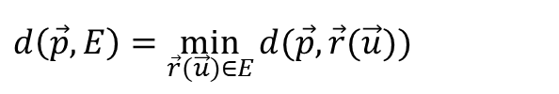



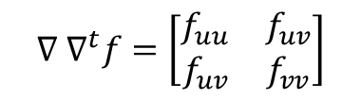




3. Preliminaries
거리 계산을 위한 기본 공식들
Point set
$$d\left(\vec{p},A\right)=\min_{i∈\{1,⋯,N_{a}\}}{d(\vec{p},\vec{a_{i}})}$$
Line set
$$d\left(\vec{p},l\right)=\min_{u+v=1}\left\|u\vec{r_{1}}+v\vec{r_{2}}−\vec{p}\right\|$$
$$d\left(\vec{p},L\right)=\min_{i∈\{1,⋯,N_{a}\}}{d(\vec{p},l_{i})}$$
Triangle set
$$d\left(\vec{p},t\right)=\min_{u+v+w=1}\left\|u\vec{r_{1}}+v\vec{r_{2}}+w\vec{r_{3}}−\vec{p}\right\|$$
$$d\left(\vec{p},T\right)=\min_{i∈\{1,⋯,N_{a}\}}{d(\vec{p},t_{i})}$$
Parametric Entity set
$$d\left(\vec{p},E\right)=\min_{\vec{r}(\vec{u})∈E}{d(\vec{p},\vec{r}(\vec{u}))}$$
$$d\left(\vec{p},F\right)=\min_{i∈\{1,⋯,N_{a}\}}{d(\vec{p}, \vec{E_{i}})}$$
최소 거리를 찾기 위한 최적화 방법 : Jacobian, Hessian 함수→ Newton =-Raphson method
Object function
$$f(\vec{u})={\left\|\vec{r}\left(\vec{u}\right)−\vec{p}\right\|}^{2}$$
$${\vec{u}}_{k+1} ={\vec{u}}_{k}−{[∇ ∇^{t}\left(f\right)\left({\vec{u}}_{k}\right)]}^{−1}∇f\left({\vec{u}}_{k}\right)$$
$$∇ f=\left[\begin{matrix}f_{u} \\ f_{v}\end{matrix}\right]$$
$$∇ ∇^{t}f=\left[\begin{matrix}f_{uu} & f_{uv} \\ f_{uv} & f_{vv}\end{matrix}\right]$$
Jacobian
Hessian
참고자료 - 뉴턴법
참고자료 – 뉴턴-랩슨

Slide 5

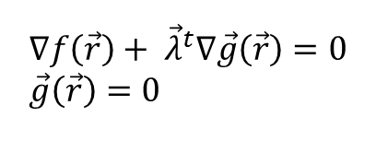



3. Preliminaries
$$\vec{g}\left(\vec{r}\right)=0$$
Implicit Entity
- 암묵적 개체는 계산을 조금 달리한다. ( solution is open-form)
$$d\left(\vec{p},I\right)=\min_{\vec{g}\left(\vec{r}\right)=0}\left\|\vec{r}−\vec{p}\right\|$$
$$d\left(\vec{p},J\right)=\min_{k∈\{1,⋯,N_{a}\}}{d(\vec{p},\vec{I_{k}})}$$
Object functoin and Optimization : Lagrange multiplier(라그랑주 승수법) → 비선형식을 수치해석적으로 푼다.
Object function
$$f\left(\vec{r}\right)={\left\|\vec{r}−\vec{p}\right\|}^{2} where \vec{g}\left(\vec{r}\right)=0$$
$$∇f\left(\vec{r}\right)+ {\vec{λ}}^{t}∇\vec{g}\left(\vec{r}\right)=0 \\ \vec{g}\left(\vec{r}\right)=0$$
Lagrange multiplier
참고자료 - 라그랑주 승수법

Slide 6




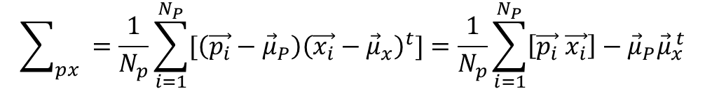


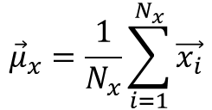
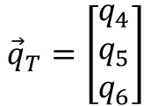
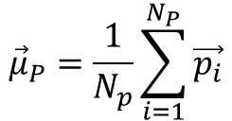
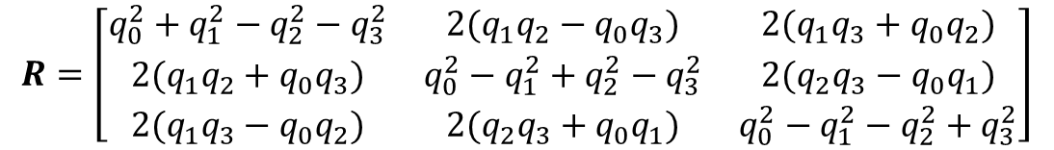
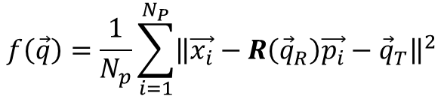
3. Preliminaries
포인트셋의 정합(1)
: 쿼터니언(Quaternion)과 교차 공분산(Cross-Covariance)을 이용하여 정합
Unit Quaternion
$${\vec{q}}_{R}={\left[q_{0}{,q}_{1},q_{2},q_{3} \right]}^{t}$$
Where $q_{0}≥0$ , $q_{0}^{2}+q_{1}^{2}+q_{2}^{2}+q_{3}^{2}=1$
$$R=\left[\begin{matrix}q_{0}^{2}+q_{1}^{2}−q_{2}^{2}−q_{3}^{2} & 2(q_{1}q_{2}−q_{0}q_{3}) & 2(q_{1}q_{3}+q_{0}q_{2}) \\ 2(q_{1}q_{2}+q_{0}q_{3}) & q_{0}^{2}−q_{1}^{2}+q_{2}^{2}−q_{3}^{2} & 2(q_{2}q_{3}−q_{0}q_{1}) \\ 2(q_{1}q_{3}−q_{0}q_{2}) & 2(q_{2}q_{3}+q_{0}q_{1}) & q_{0}^{2}−q_{1}^{2}−q_{2}^{2}+q_{3}^{2}\end{matrix}\right]$$
Rotation matrix
Transition matrix
$${\vec{q}}_{T}=\left[\begin{matrix}q_{4} \\ q_{5} \\ q_{6}\end{matrix}\right]$$
Complete Registration state vector
Measured data point
Model point
$$\vec{q}={\left[{\vec{q}}_{R}|{\vec{q}}_{T}\right]}^{t}$$
$$P=\{\vec{p_{i}}\}$$
$$X=\{\vec{x_{i}}\}$$
corresponding
Mean square Object function
$$f\left(\vec{q}\right)=\frac{1}{N_{p}}\sum_{i=1}^{N_{P}}{{\left\|\vec{x_{i}}−R\left({\vec{q}}_{R}\right)\vec{p_{i}}−{\vec{q}}_{T}\right\|}^{2}}$$
$${\vec{μ}}_{P}=\frac{1}{N_{p}}\sum_{i=1}^{N_{P}}{\vec{p_{i}}}$$
$${\vec{μ}}_{x}=\frac{1}{N_{x}}\sum_{i=1}^{N_{x}}{\vec{x_{i}}}$$
mean(Sum of square error)
초기 Transition 을 위한 center of mass
Cross Covariance matrix
Cost
$$\sum_{px}{ }=\frac{1}{N_{p}}\sum_{i=1}^{N_{P}}{[\left(\vec{p_{i}}−{\vec{μ}}_{P}\right){\left(\vec{x_{i}}−{\vec{μ}}_{x}\right)}^{t}]}=\frac{1}{N_{p}}\sum_{i=1}^{N_{P}}{\left[\vec{p_{i}} \vec{x_{i}}\right]−{\vec{μ}}_{P}{\vec{μ}}_{x}^{ t}}$$
$$O\left(N_{P}\right)$$

Slide 7





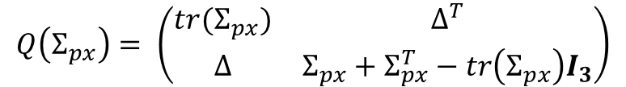
3. Preliminaries
포인트셋의 정합(2)
: 고유벡터와 고유값의 활용을 통한 Optimal Rotation 도출 및 Optimal translation
$$A_{ij}={\left(Σ_{px}−Σ_{px}^{T}\right)}_{ij}$$
$$∆={\left[ A_{23} A_{31} A_{12}\right]}^{T}$$
Anti-symmetric matrix
(반대칭행렬)
$$Q\left(Σ_{px}\right)= \left(\begin{matrix}tr(Σ_{px}) & ∆^{T} \\ ∆ & Σ_{px}+Σ_{px}^{T}−tr\left(Σ_{px}\right)I_{3}\end{matrix}\right)$$
Eigen value를 구하기 위한 행렬
$$Q\left(Σ_{px}\right)$$
의 최대값에 대응하는 단위 고유벡터가 최적 회전을 나타낸다.
$${\vec{q}}_{R}={\left[q_{0}{,q}_{1},q_{2},q_{3} \right]}^{t}$$
Optimal Translation vector
$${\vec{q}}_{T}={\vec{μ}}_{x} −R({\vec{q}}_{R}){\vec{μ}}_{p}$$

Slide 8









4. ICP 알고리즘
알고리즘의 설명
“data” shape P is moved to be “model” shape X
$N_{p}$개의 점 $\{p_{i}\}로$ 이루어져 있는 data shape Point set P와 $N_{x}$개의 점, 선분 또는 삼각형같은 형상으로 구성된 Model shape X가 주어짐,
초$기위치$ $P_{0}=P, 정$합 벡터 ${\vec{q}}_{0}={\left[1,0,0,0,0,0,0\right]}^{t}$, k = 0으로 초기화 하며, Registration vector는 초기 데이터셋 $P_{0}$에 상대적으로 정의된다. 최종 정합이 전체 변환을 의미한다.
알고리즘의 수행
최근접점의 계산
정합 계산
정합 적용
반복종료조건 : 미리 설정한 임계점보다 오차가 낮아지면 종료
Operator
Worst case Cost
average Cost
$$Y_{k}=C(P_{k},X)$$
$$O\left(N_{P}N_{x}\right)$$
$$O\left(N_{P}\log{N_{x}}\right)$$
K번째 P
$$\left({\vec{q}}_{k} ,d_{k}\right)=Q(P_{0},Y_{k})$$
$$O\left(N_{p}\right)$$
$$P_{k+1}={\vec{q}}_{k}(P_{0})$$
$$O\left(N_{p}\right)$$
$$d_{k}− d_{k+1}<τ$$

Slide 9
4. ICP 알고리즘
알고리즘의 증명 (수렴정리)

Slide 10
4. ICP 알고리즘
알고리즘의 개선 (Accelerated ICP)
Newton method 의 사용
그 외의 방법은 별로 안좋아서 생략

Slide 11
5. Set of Initial Registrations
알고리즘의 개선 (Accelerated ICP)
Newton method 의 사용
그 외의 방법은 별로 안좋아서 생략

Slide 12
6. 실험 결과
Point Set matching
Curve matching

Slide 13
6. 실험 결과
Surface Matching
기본
African Mask
Terrain Data

Slide 14
7. Conclusion
Pros
Cons

Slide 15
Appendix.
Generaliezed-ICP (G-ICP)

Slide 16
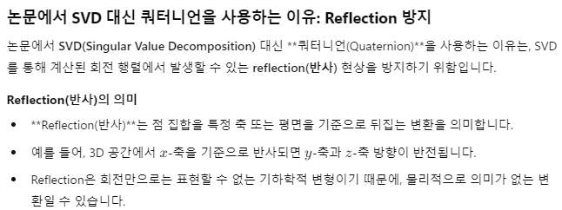
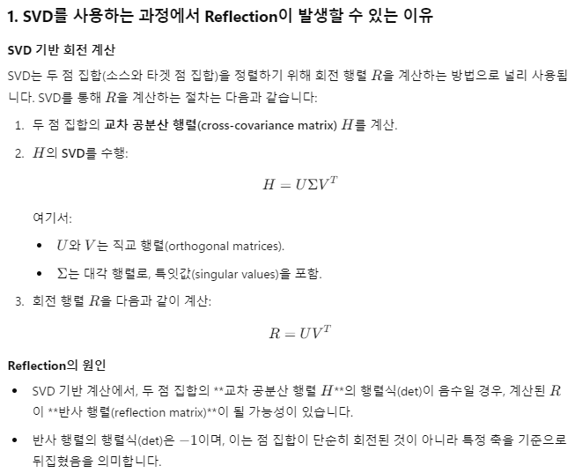
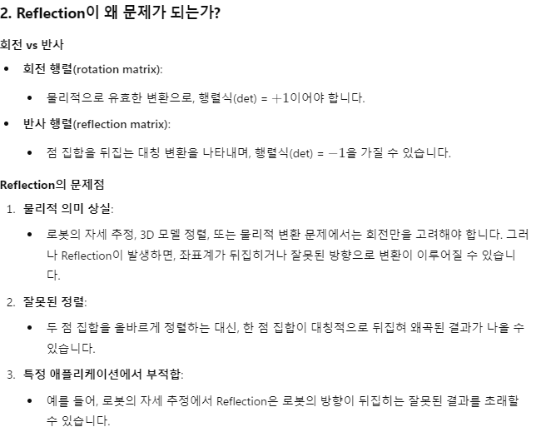
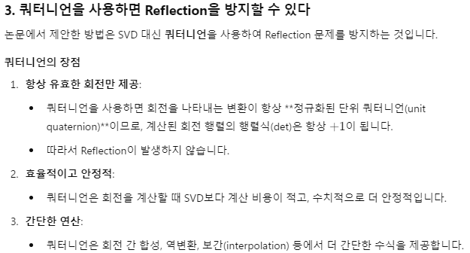
Appendix.

